Slide 1
Source Code Management: Branching and Merging
Jay Smith

Slide 2
The Problem
Version 1.0 of application X was released 4 weeks ago and development work on version 2.0 is in full swing and a bug has been discovered.
The current state of the project won’t allow you to just fix the bug and release.
What do you do?

Slide 3
Branching
Branching is the duplication of an object under revision control (such as a source code file, or a directory tree) so that modifications can happen in parallel along both branches.

Slide 4
Branching Per Release
Version 1.0
Version 1.1
Version 1.2
Version 1.3
RELEASE 1
branch
merge
RELEASE 2
Version 2.0
Version 2.1
Version 2.2
Version 2.3

Slide 5
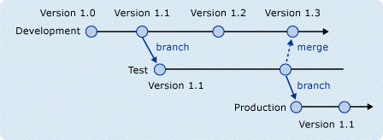
Copy Promotion Branch

Slide 6
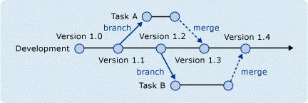
Branch Per Task

Slide 7
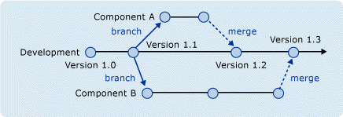
Branch Per Component

Slide 8
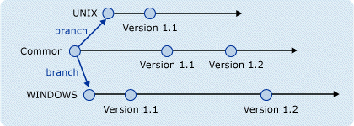
Branch Per Technology

Slide 9
Resources
VS 2005 Technical Article: Branching and Merging by Chris Brimele
Team Foundation Server Branching Guidance by John Jacob, Mario Rodriguez, and Graham Barry
Version Control with Subversion – Chapter 4
http://delicious/jay.smith/SCM

